Slide 1

EXPLORE AI - INTEGRATED PROJECT
MOSHIBUDI MODIBA

Slide 2
Project Landscape
 | DATA | INFORMATION | KNOWLEDGE
Underwritting Engine | What sources are available for collecting data on insured individuals and properties in Africa? | How can the underwriting engine be optimized to better identify and evaluate potential clients? | Are there any regulatory changes or market dynamics that could impact future insurance operations?
Price Risk | How can machine learning algorithms be leveraged to improve underwriting accuracy and risk pricing? | How is risk price currently determined for insurance policies in Africa? | What strategies can be implemented to attract and retain clients within these segments?
Margin | What measures are in place to ensure the security and privacy of insurance data in Africa? | How can margins be optimized while ensuring competitiveness and profitability? | What feedback mechanisms are in place to gather insights from clients, agents, and stakeholders?

Slide 3
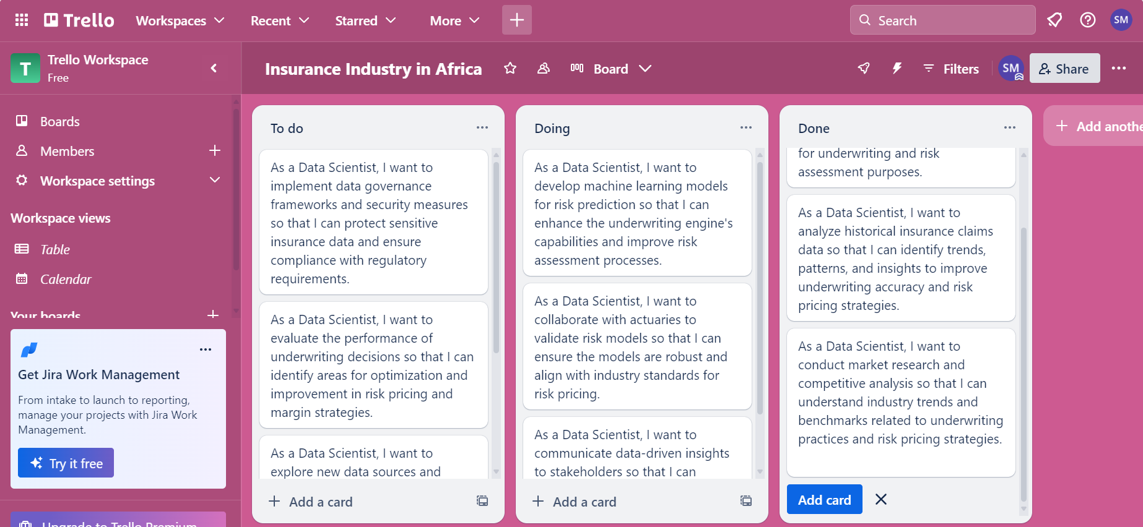
Trello Board

Slide 4
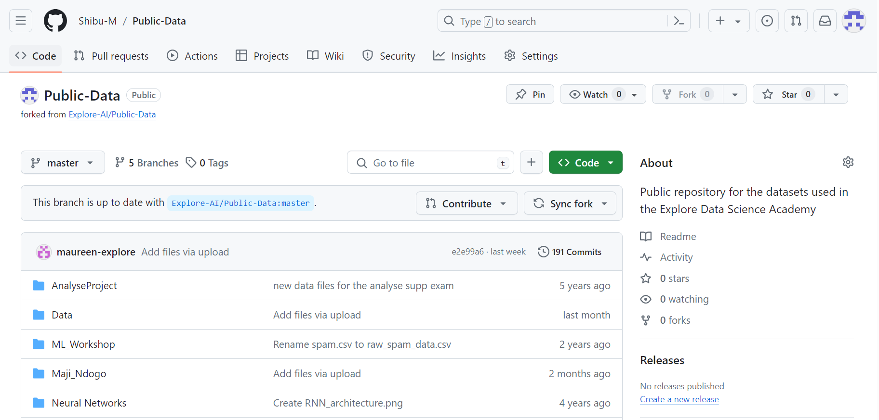
Forked Repo

Slide 5
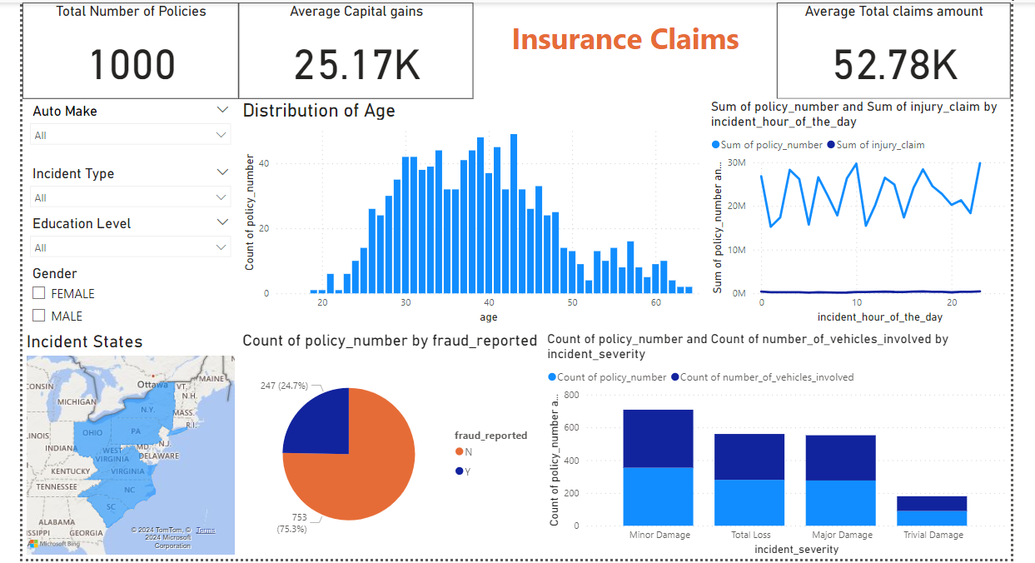
PowerBI Dashboard

Slide 6
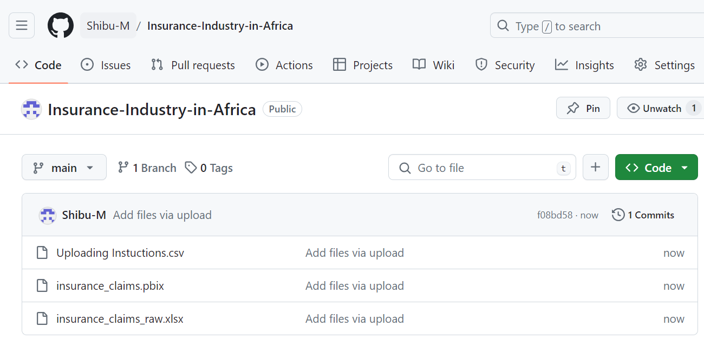
GitHub Link
Shibu-M/Insurance-Industry-in-Africa (github.com)

